Slide 1
CURVES AND SURFACES

Slide 2
BEZIER CURVE
Specified by set of coordinates known as control points
Control points indicates the shape of the curve
A Bezier curve is an approximation curve

Slide 3
P₁
P₂
Characteristic polygon
or
Control polygon
P₃
P₀

Slide 4
P₁
P₂
P₀
P₃
Bezier basis function
or
Bernstein polynomial

Slide 5
Quartic Bezier Curve
Quintic Bezier Curve
N^{th} degree Bezier Curve

Slide 6
Properties of BEZIER CURVE
Property-I.
a)Tangent (f’) at each endpoint is defined by the endpoint and the adjacent point
b) Curvature(f’’) at each endpoint is defined by the endpoint and its two adjacent points
c) f’’’ at each endpoint is defined by the endpoint and its three adjacent points

Slide 7
Properties of BEZIER CURVE
Property-II.
Reversing the sequence of control points does not change the shape of the curve
P₁
P₂
P₂
P₁
P₃
P₃
P₀
P₀

Slide 8
Properties of BEZIER CURVE
Property-III.
The curve is invariant under translation, rotation, scaling and sheering
P₂
P₁
P₁
P₂
P₀
P₃
P₃
P₀

Slide 9
Properties of BEZIER CURVE
P₁
P₂
P₀
P₃
Property-IV.(Property of convex hull)
The curve lies entirely inside characteristic polygon
Bound of a curve
Two Bezier curves are intersecting or not

Slide 10
Properties of BEZIER CURVE
P₁
P₂
P₀
P₃
Property-V.
The curve exhibits partition of unity

Slide 11
Properties of BEZIER CURVE
P₁
P₂
P₀
P₃
Property-VI.
The curve can be represented in matrix form

Slide 12
Global propagation of change
Changing one control point changes the globally
Local propagation of change
Changing one control point changes the locally

Slide 13
Piecewise BEZIER CURVE
N=9
Control points:10
P₀
P₁
P₂
P₃
P₄
P₅
P₆
P₇
P₈
P₉

Slide 14
Implementation issue
Void Bezier(int x[],int y[])
{
for (u=0;u<1;u=u+0.0005)
{
float xu=f(x,u);
float yu=f(y,u);
}
plot_point(round(x(u)),round(y(u)),COLOR);
}

Slide 15
BEZIER SURFACE
Cubic Bezier curve
Cubic-Cubic Bezier surface / Bi-cubic Bezier surface

Slide 16
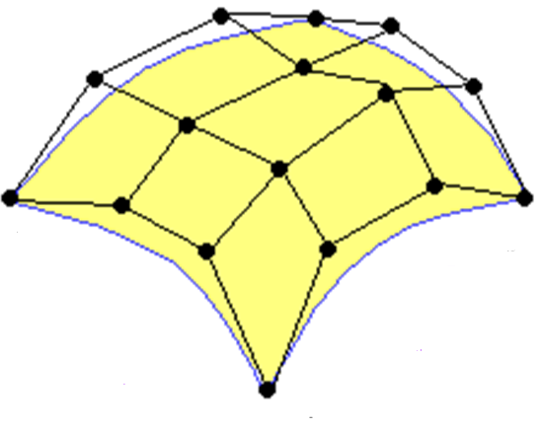
Bi-cubic Bezier surface
P₈
P₁₂
P₁₃
P₄
P₁₄
P₉
P₅
P₁₀
P₀
P₆
P₁₅
P₁
P₁₁
P₂
P₇
P₃
https://www.google.co.in/url?sa=i&rct=j&q=&esrc=s&source=images&cd=&cad=rja&uact=8&ved=&url=http%3A%2F%2Ffuzzyphoton.tripod.com%2Frtref%2Frtref_b.htm&psig=AFQjCNE1pIh6AKewLh2bHw6umQ49XOtdRQ&ust=1467879043590516

Slide 17
Properties of BEZIER SURFACE
Passes through four corner points
Tangent vectors are defined by adjacent points
Convex hull
Partition of unity

Slide 18
Non uniform B-SPLINE CURVE
Order of curve: K
No. of control points: N+1
No of segments of a curve:N-K+2
B-Spline basis function

Slide 20
Non uniform B-SPLINE CURVE example
Order of curve:
K =3
No. of control points:
N+1=7
No of segments of a curve:
N-K+2=5
P₂
P₁
P₃
_{U=2}
[P₀,P₁,P₂]
_{U=1}
P₆
P₀
_{U=3}
_{U=5}
_{U=0}
_{U=4}
P₄
P₅
SEGMENT | U₁ | U₂ | CONTROL POINT
Segment-1 | 0 | 1 | [P₀,P₁,P₂]
Segment-2 | 1 | 2 | [P₁,P₁,P₃]
Segment-3 | 2 | 3 | [P₂,P₃,P₄]
Segment-4 | 3 | 4 | [P₃,P₄,P₅]
Segment-5 | 4 | 5 | [P₄,P₅,P₆]

Slide 21
CONTROL POINT | SEGMENT | NUMBER OF SEGMENT(S)
P₀ | Segment-1 | 1
P₁ | Segment-1 Segment-2 | 2
P₂ | Segment-1 Segment-2 Segment-3 | 3
P₃ | Segment-2 Segment-3 Segment-4 | 3
P₄ | Segment-3 Segment-4 Segment-5 | 3
P₅ | Segment-4 Segment-5 | 2
P₆ | Segment-5 | 1
SEGMENT | U₁ | U₂ | CONTROL POINT
Segment-1 | 0 | 1 | [P₀,P₁,P₂]
Segment-2 | 1 | 2 | [P₁,P₁,P₃]
Segment-3 | 2 | 3 | [P₂,P₃,P₄]
Segment-4 | 3 | 4 | [P₃,P₄,P₅]
Segment-5 | 4 | 5 | [P₄,P₅,P₆]

Slide 22
CONTINUITY
C₀ continuity/Point Continuity
All points are connected
C₁ continuity/Slope Continuity
All points have unique slope(f’)
C₂ continuity/Curvature Continuity
All points have unique curvature(f’’)

Slide 23
Properties of Non uniform B-SPLINE CURVE
The curve is C_{K-2} continuous
Made up of N-K+2 segments
Only K control points affect any segment
A control point affects at most K curve segments

Slide 24
Non uniform B-SPLINE SURFACE
Non uniform B-SPLINE curve
Non uniform B-SPLINE surface

Slide 25
Non uniform rational B-SPLINE
(NURBS)
NURBS curve
h_{i} is the weightage of x_{i}
Family of NURBS
h_{i}=1 for non uniform B-Spline
NURBS surface

Slide 26
END OF CHAPTER

